Slide 1






Me-fi Prototype
AC4150E- HUMAN MACHINE INTERACTION
CAIN

Slide 2




Our Team
Phung Minh Chien
Ma Khoa Hoc
Nguyen Danh Huy
20213565
20210388
20213571

Slide 3


Today, we’ll talked about
Project Intro
04
Problem & Solution
06
Encoding Values
08
Tasks
13
Usability Goals
15
Interface Revisions
18
Med-fi Task Flows
21
Prototype Implementation
28

Slide 4



Project Intro

Slide 5

CAIN
Connecting Answers & Inspiring New possibilities

Slide 6
Problem & Solution

Slide 7


Problem
Solution
Many individuals struggle to locate specific information within lengthy or complex documents, often wasting valuable time and effort.
CAIN allows users to upload documents and instantly provides accurate answers to their questions, streamlining access to critical information.
Can CAIN help users instantly find answers by querying uploaded documents?

Slide 8
Encoding Values

Slide 9
Value Definition
Inclusivity
Intuitiveness
Flexibility
CAIN must be accessible and useful to a wide variety of users, including novice, expert, and disabled individuals.
Users should be able to navigate, search, and utilize CAIN's functionalities without confusion or unnecessary effort.
CAIN must adapt to diverse user needs, supporting both simple tasks and complex workflows.
Operation

Slide 10
Value Definition
Efficiency
Transparency
Playfulness
CAIN should save users time by delivering fast and accurate results.
CAIN must maintain user trust by ensuring clarity in operations and data handling.
Interaction with CAIN should feel engaging and enjoyable for the user.
Operation

Slide 11
Value-Aligned Features
Inclusivity
Intuitiveness
Flexibility
A user-friendly interface with intuitive navigation to support novice users.
Robust accessibility options such as screen reader compatibility, customizable text sizes, and high-contrast themes.
Features to onboard users of all technical levels with guided tutorials and tooltips.
Clear and distinct icons for features like notebook search, file uploads, and summaries.
Contextual suggestions and autofill options for document searches.
Streamlined user flows for task execution, reducing the number of clicks needed to complete actions.
Options to analyze multiple documents simultaneously or focus on a single file.
Ability to tailor output styles for summaries (e.g., concise, detailed, or formal tone).
Adjustable preferences for task automation and manual control.
Operation

Slide 12
Value-Aligned Features
Efficiency
Transparency
Flexibility
Quick response times for keyword searches, document comparisons, and summaries.
Visual progress indicators for analysis tasks.
Keyboard shortcuts for power users to perform repetitive tasks faster.
Clearly visible data handling policies and permissions.
Visual explanations of how analyses are conducted and how results are derived.
Transparent limitations for hardcoded elements and simulated features in prototypes.
Personalized feedback and interactive visuals during document analysis.
Animations, such as a loading bar that transforms into a progress tracker with encouraging messages.
Gamified elements like badges for mastering features or completing tasks efficiently.
Operation

Slide 13
Task Overview

Slide 14

01
Simple
Search notebook by name using search bar
Tasks
02
Moderate
Chat to ask about chosen file
03
Complex
Upload File to Notebook

Slide 15
Usability Goals & Key Measurements

Slide 16
Intuitive Navigation
Efficient Task Completion
Rationale: Users should complete document-related tasks (searching, chatting, uploading) quickly and accurately with minimal effort.
Key Measurement:
Task Completion Time: Time taken for each task:
Simple Task (Search Notebook): (Target: ≤ 5 seconds)
Moderate Task (Chat with File): (Target: ≤ 15 seconds)
Complex Task (Upload File): (Target: ≤ 20 seconds)
Task Success Rate: Percentage of tasks successfully completed on the first attempt. (Target: ≥ 95%)
Rationale: Ensure users can easily navigate CAIN’s interface to perform tasks like searching notebooks, asking questions, and uploading files without confusion.
Key Measurement:
Mis-clicks: Track the number of incorrect interactions during tasks. (Target: ≤ 2 mis-clicks per task)
Navigation Time: Measure the time taken to locate key features (search bar, chat interface, file upload). (Target: ≤ 10 seconds)
CAIN allows users to upload documents and instantly provides accurate answers to their questions, streamlining access to critical information.

Slide 17
Intuitive Navigation
Efficient Task Completion
Progress Toward Goal:
Clear search bar placement with autocomplete suggestions to simplify notebook searches.
Chat interface refined for seamless interaction with chosen files, including visual file indicators.
Reorganized file upload flow to reduce steps, making it faster and more intuitive.
Progress Toward Goal:
Optimized search algorithm for faster notebook retrieval by name.
Enhanced chat system to provide real-time, accurate responses with clear prompts for file-related queries.
Simplified upload interface with drag-and-drop support and progress indicators to improve speed and user satisfaction.

Slide 18
Interface Revisions

Slide 19
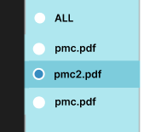
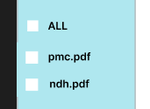
Major design change #1
Change the radio buttons to checkboxes for selection so that users know they can select multiple files simultaneously

Slide 20
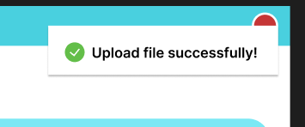
Major design change #2
Add a pop-up that disappears after 5 seconds to notify the user that the file was uploaded successfully

Slide 21
Med-fi Task Flows

Slide 22

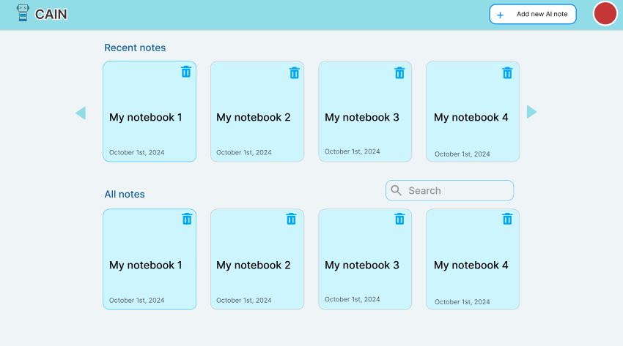
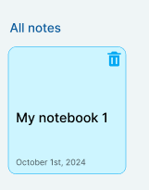

Simple Task
Search notebook by name using search bar
Allow the user to type in a notebook name, and display the corresponding notebook

Slide 23
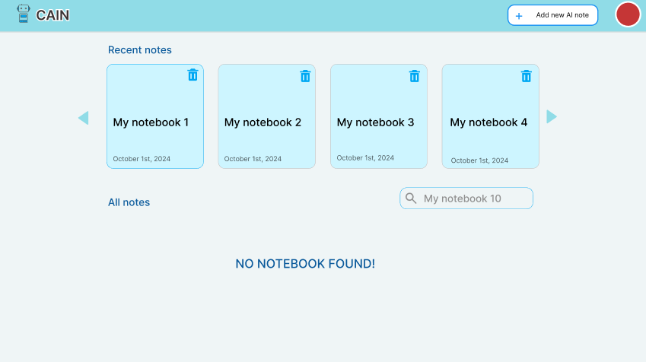


Simple Task
Search notebook by name using search bar
If there no match notebook name, it appear “NO NOTEBOOK FOUND!”

Slide 24
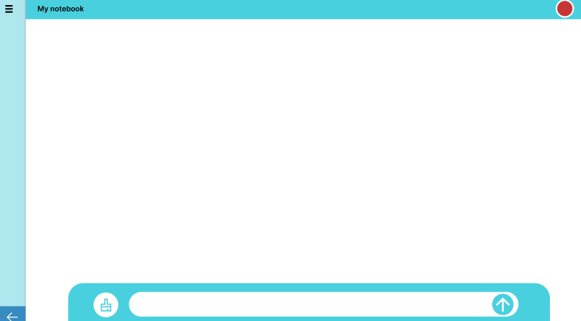
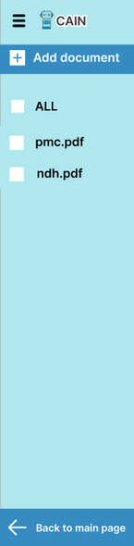

Moderate Task
Chat to ask about chosen file
First, allow the user to choose one chatbox to start with.
Then, the first UI of the chatbox appears. The user can select the three-dash icon in the top-left corner to display the document list.

Slide 25
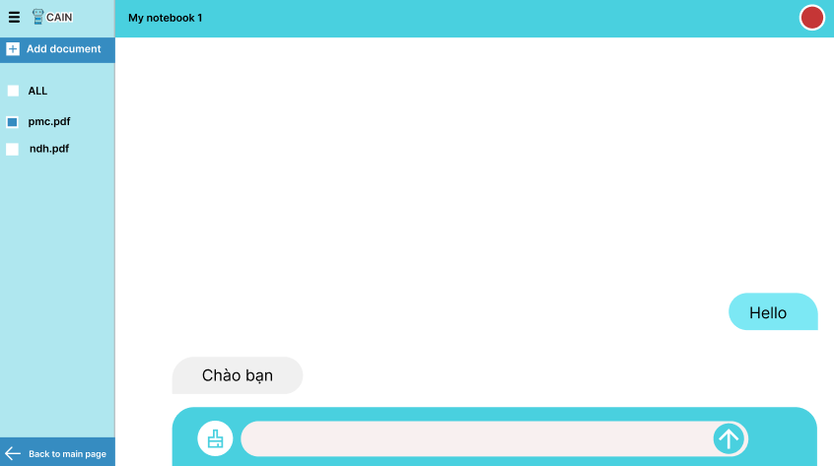
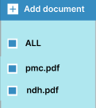
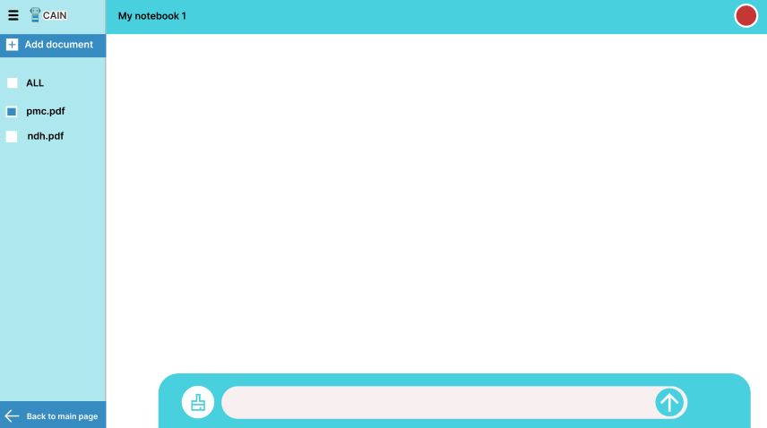


Moderate Task
Chat to ask about chosen file
The user can select one or multiple files to start chatting with CAIN
While the bot is processing, a three-dot loading indicator pops up.
Type something to ask about the document

Slide 26
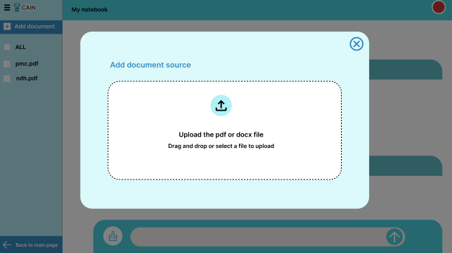
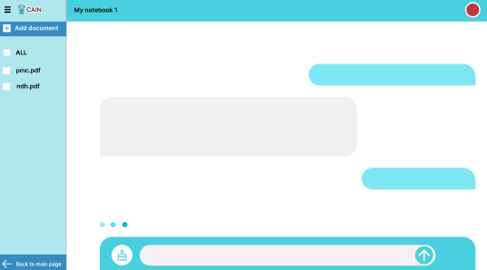

Complex Task
Upload File to Notebook
Inside the chatbox, the user can choose to add a new document, located right above the document list and below the three-dash menu option.
And the Upload Document UI will appear.

Slide 27
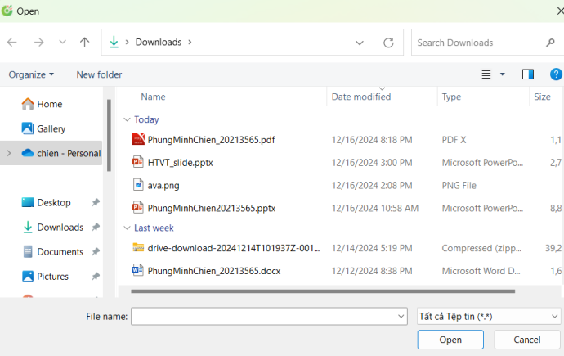
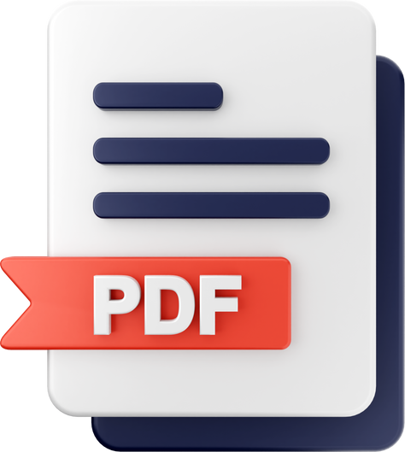
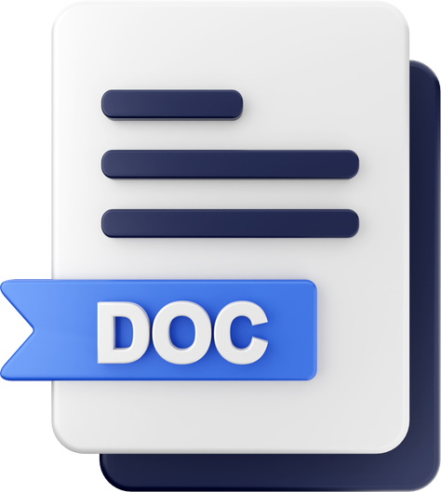
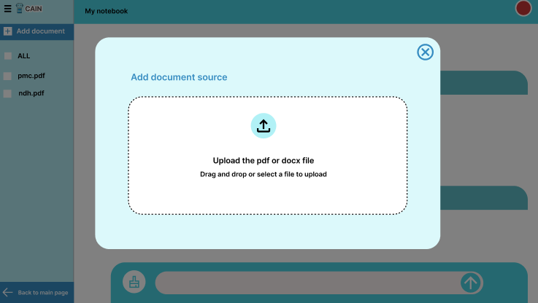

Complex Task
Upload File to Notebook
The user can drag a document from their computer or click the area, which will open a familiar browser window
Familiar browser window appear.
Clicking 'Open' triggers a popup to notify the user whether the file was uploaded successfully or not

Slide 28
Prototype Implementation

Slide 29

Design & Prototyping Tools
Figma:
Pros:
Easy to collaborate with team members using comments and shared libraries.
Allows for interactive prototyping to simulate user flows for all tasks (search, chat, and upload).
Supports design consistency with reusable components and grid systems.
Cons:
Complex prototypes with multiple interactions may become difficult to manage.
Requires duplicating screens to simulate dynamic interactions (e.g., chat responses or file uploads).

Slide 30

THANK YOU!

